Slide 1
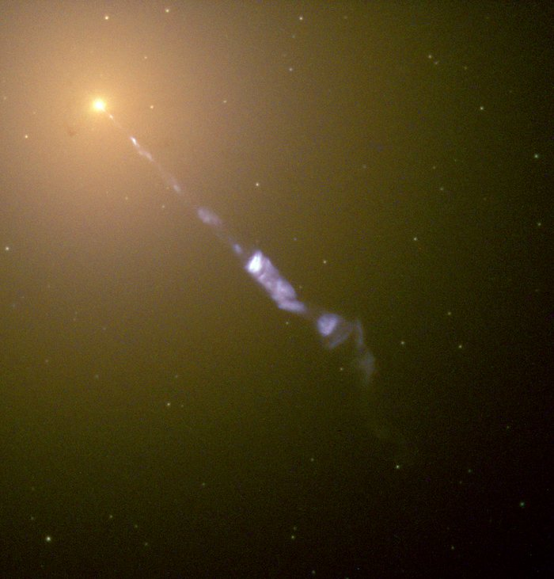



Investigating Supermassive Black Holes and Their Variability Using Structure Functions
By Derek Blue
Co-Supervised by Dr. Tina Harriott and Dr. Luigi Gallo
Image Credit: http://hubblesite.org/image/968/news_release/2000-20

Slide 2
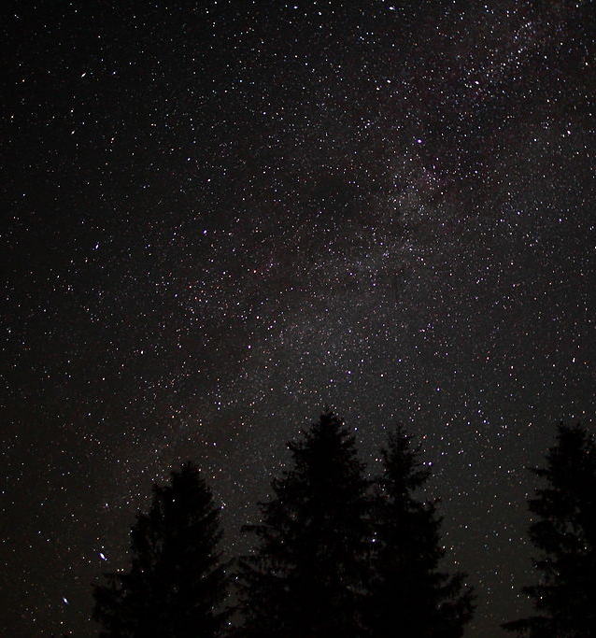
A brief introduction to the universe
This Photo by Unknown Author is licensed under CC BY-SA
Populated by Gas, Dust, and Stars
Collections of gas, dust, and stars called galaxies
Galaxies come in all shapes and sizes

Slide 3
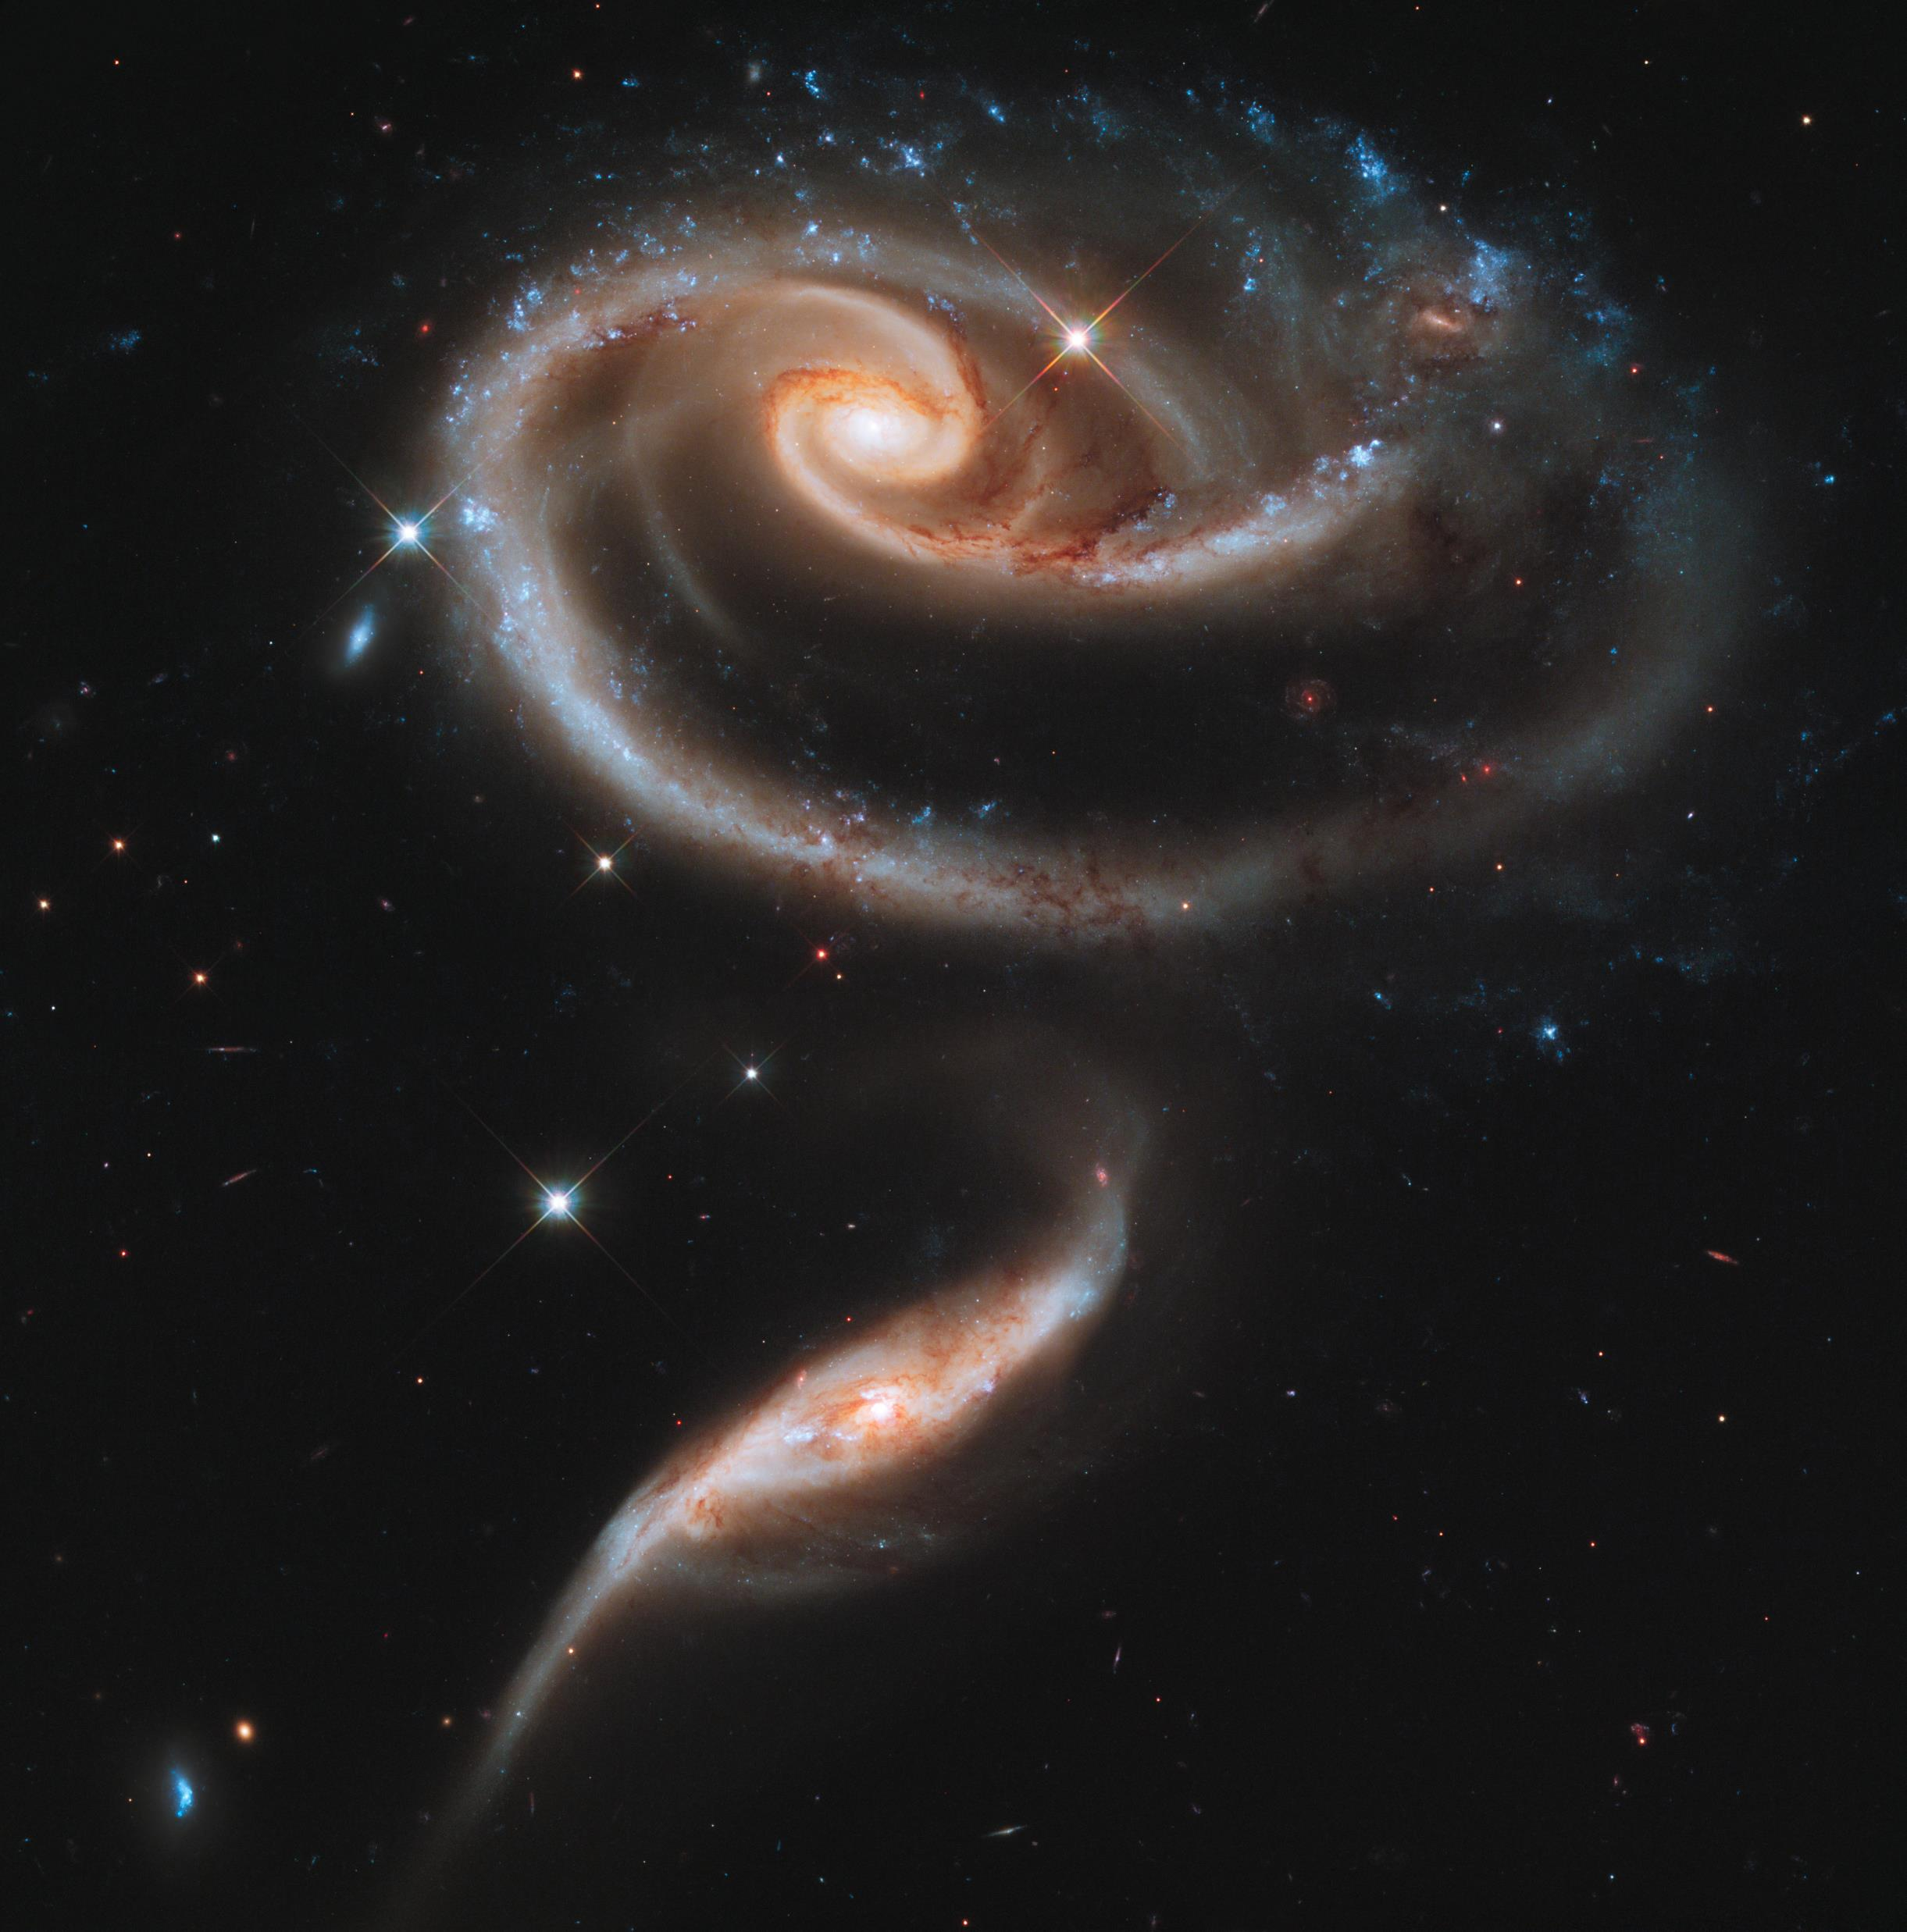
Relatively dim compared to stars
Originally described as “great clouds of stars”
Broken into three main groups
Hosts to supermassive black holes in their centers
Galaxies
Image Credit: ESA/Hubble & NASA - https://www.spacetelescope.org/images/heic1107a/

Slide 4
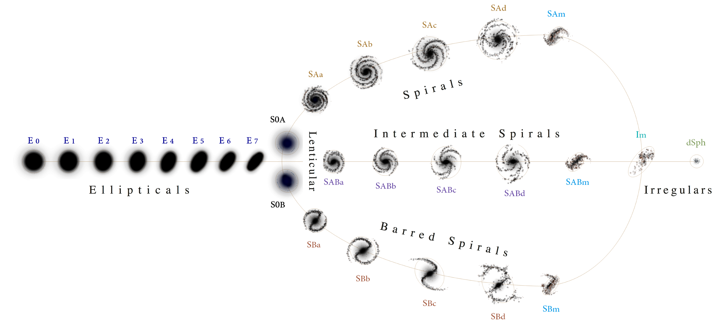
Galaxy Classification
Image Credit: https://commons.wikimedia.org/wiki/File:Hubble\_\_de\_Vaucouleurs\_Galaxy\_Morphology\_Diagram.png

Slide 5

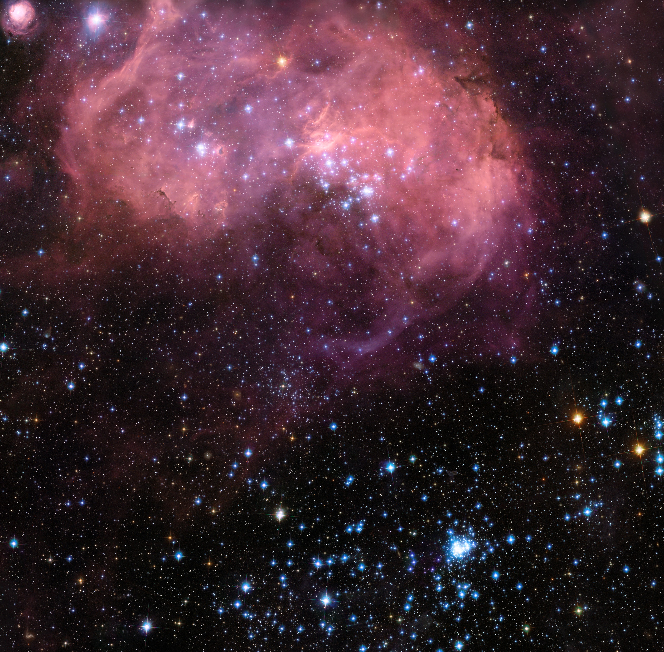
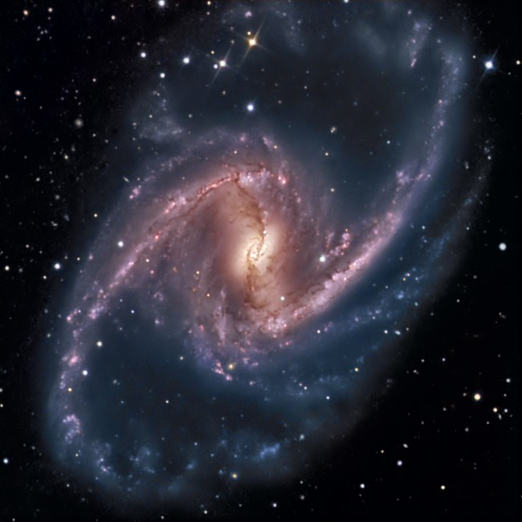
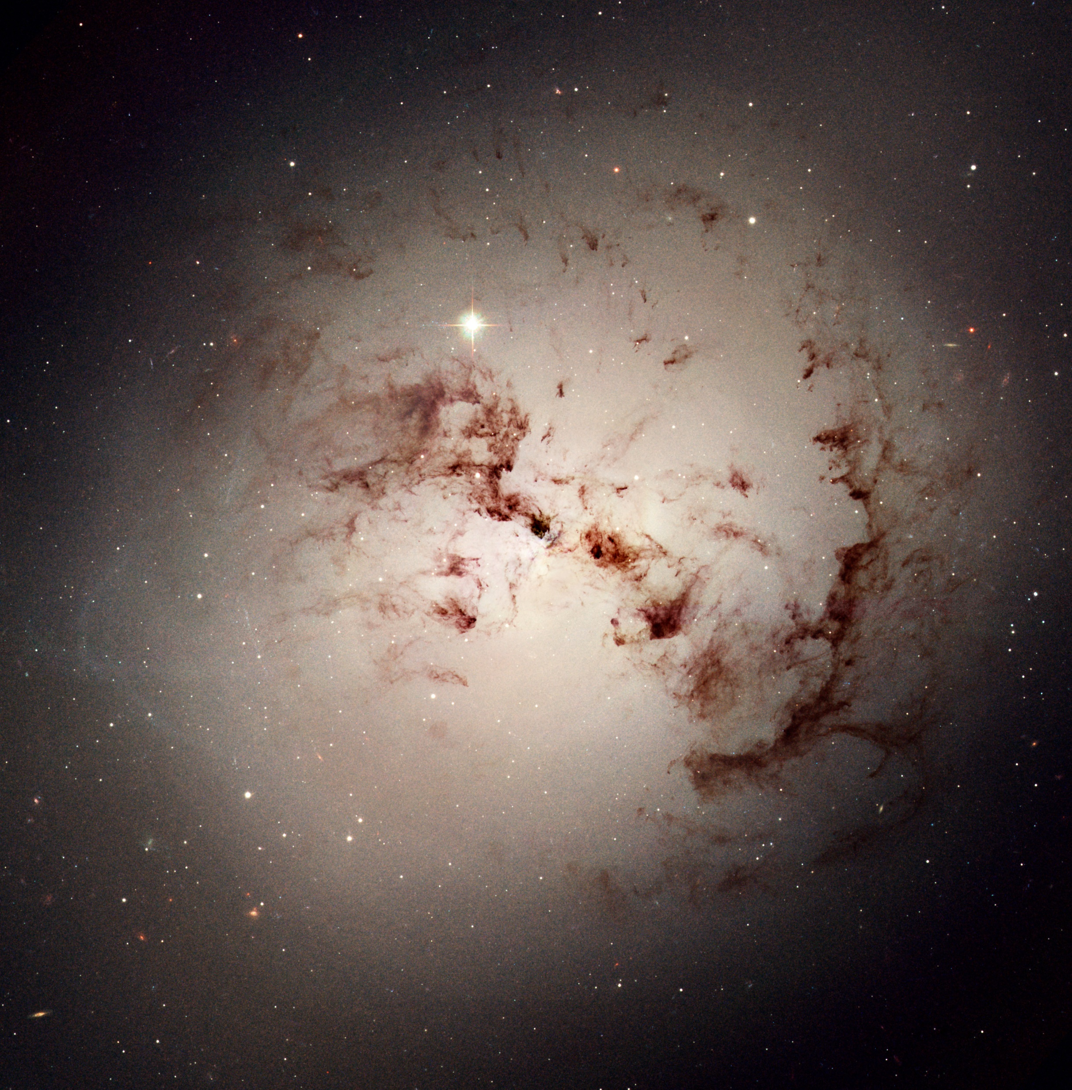
Galaxy Examples
Image Credits: ESA/Hubble & NASA - https://www.spacetelescope.org

Slide 6

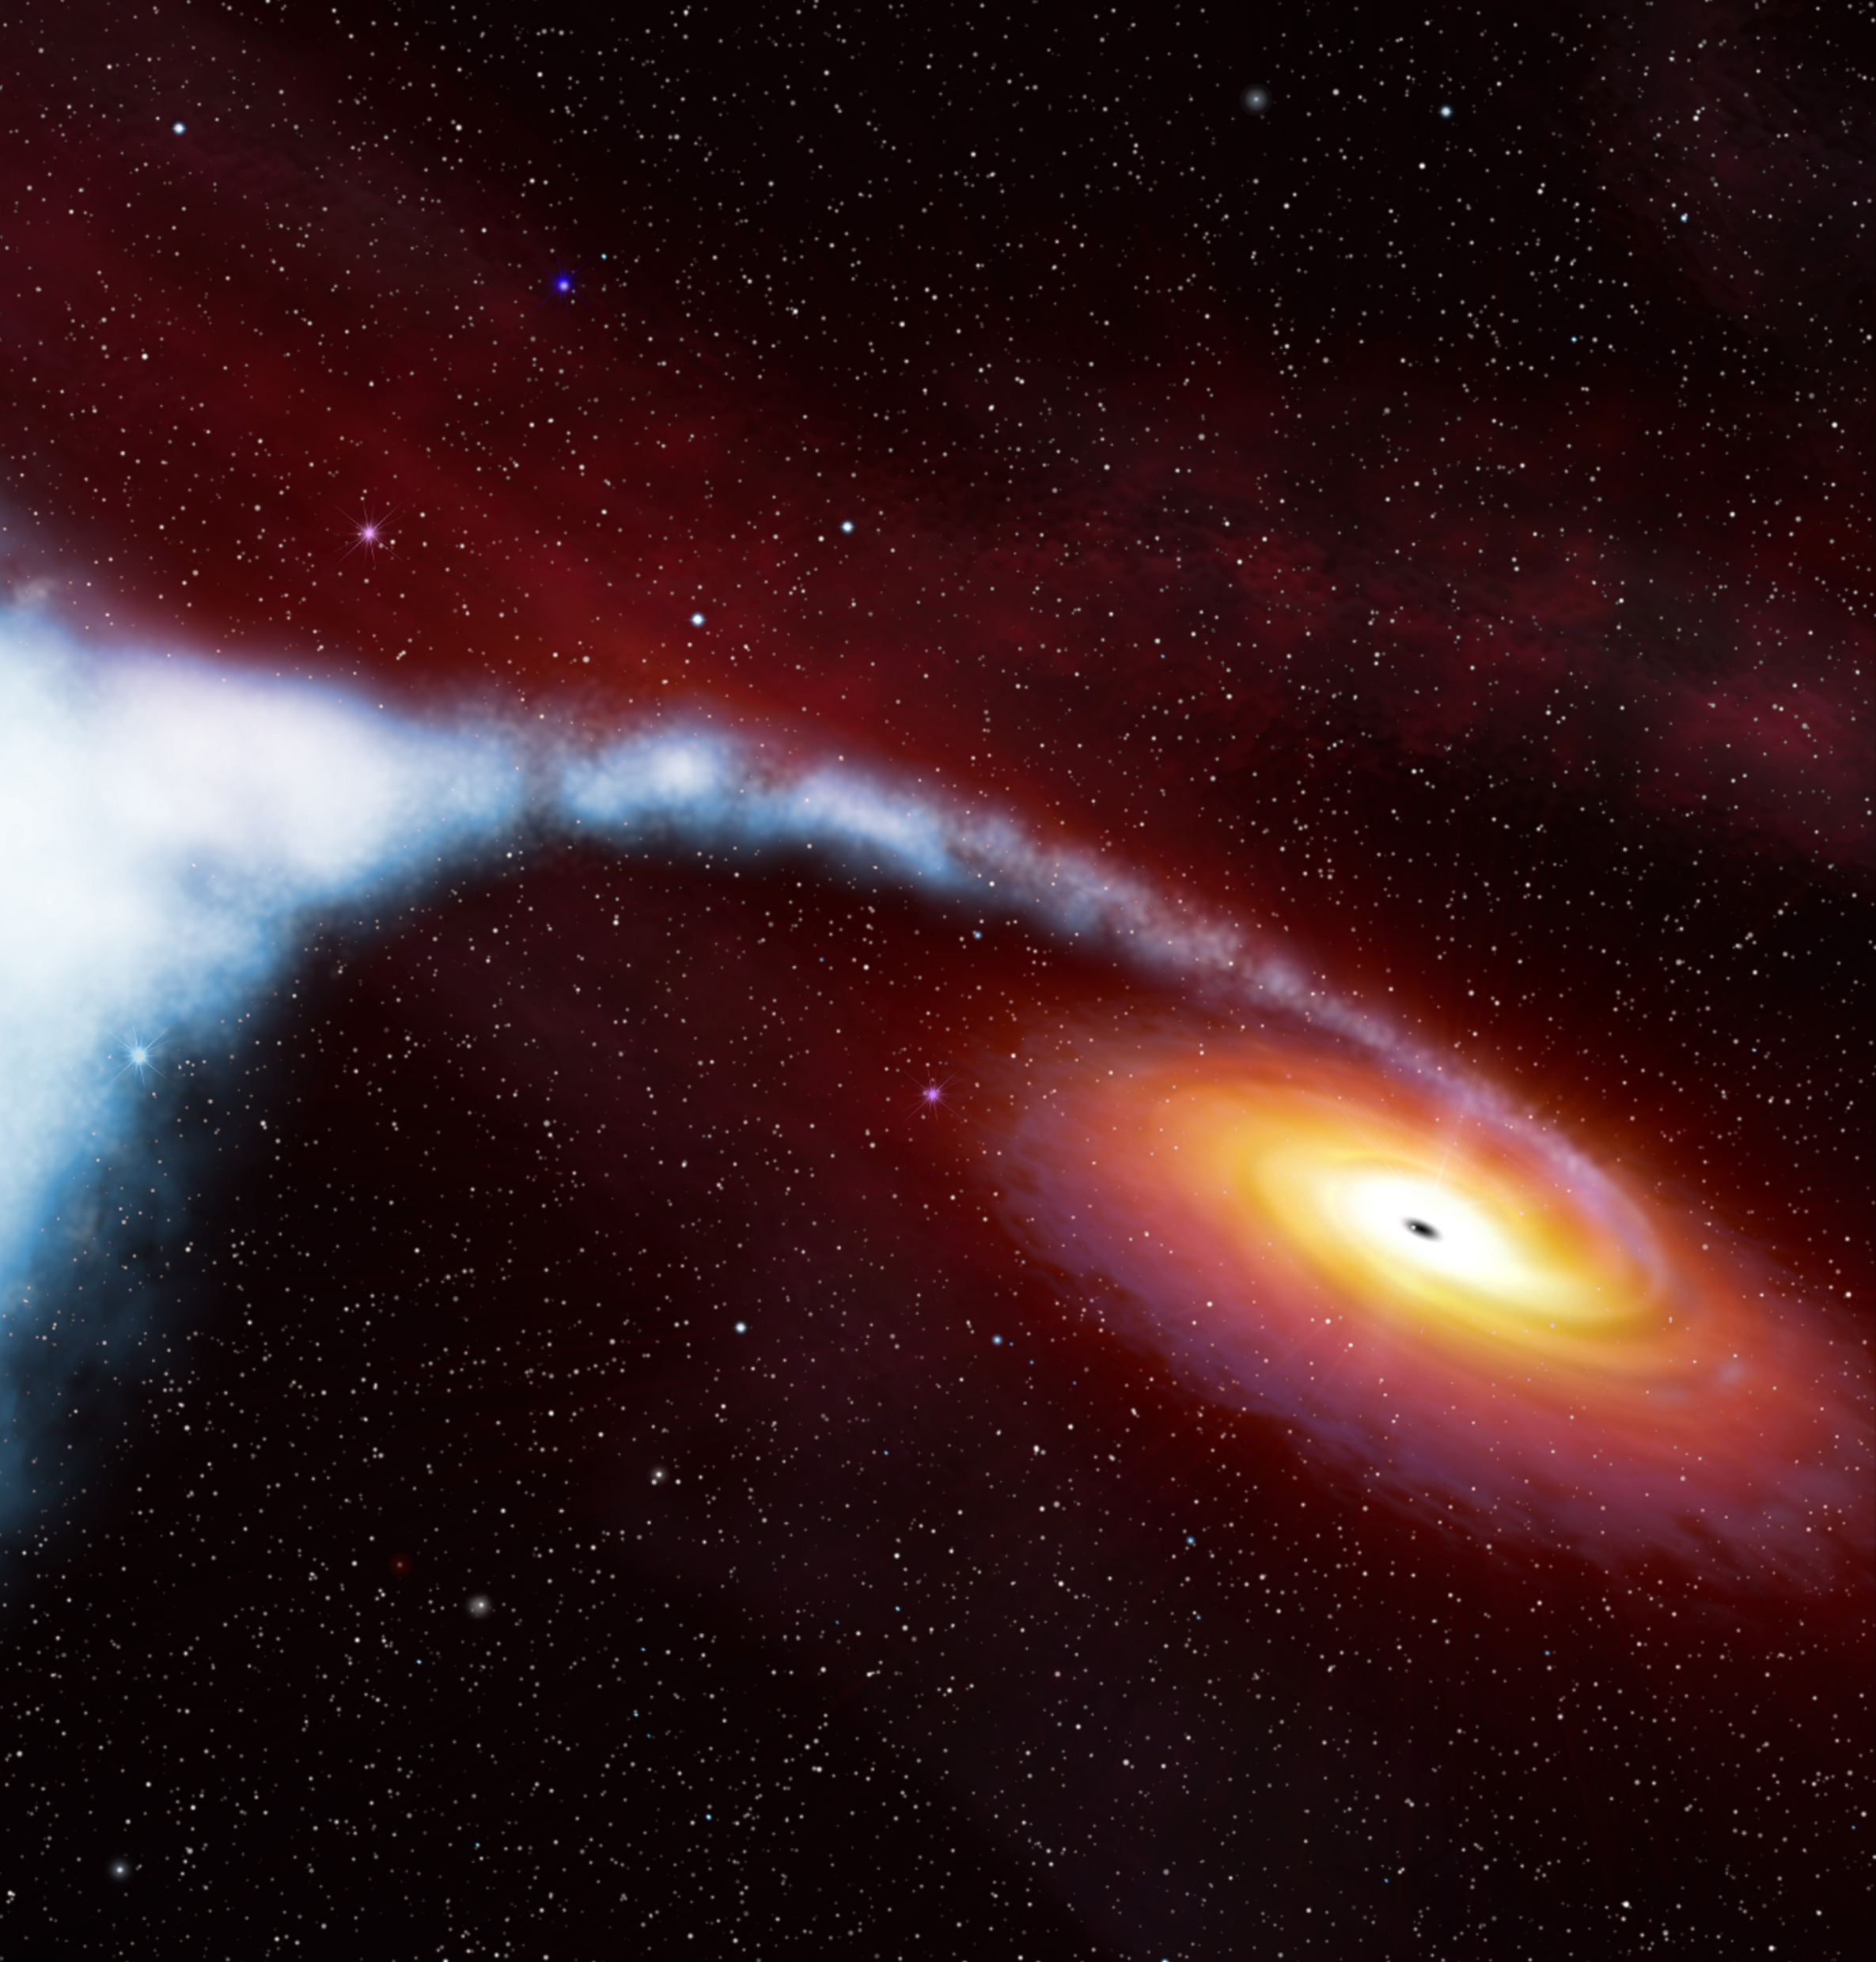
Black Holes
Massive enough to affect light
Named for their regions inside which light cannot escape
Image Credit: ESA/Hubble & NASA - https://www.spacetelescope.org/images/cygx1\_illust\_orig/

Slide 7
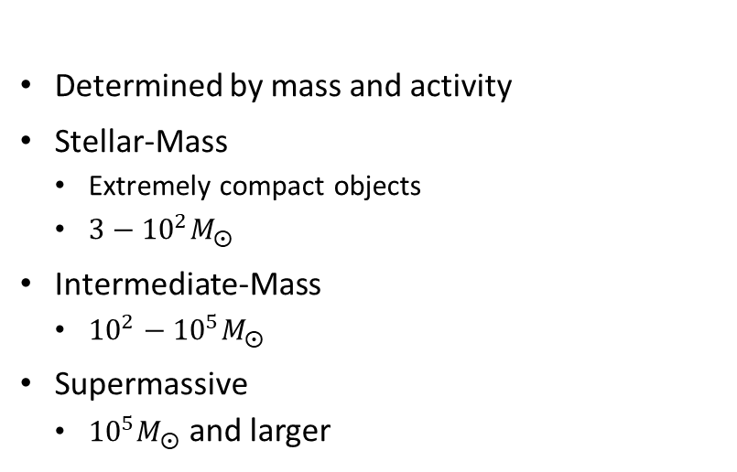
Types Of Black Holes
Determined by mass and activity
Stellar-Mass
Extremely compact objects
$3−{10}^{2}M_{⨀}$
Intermediate-Mass
${10}^{2}−{10}^{5}M_{⨀}$
Supermassive
${10}^{5}M_{⨀}$ and larger

Slide 8
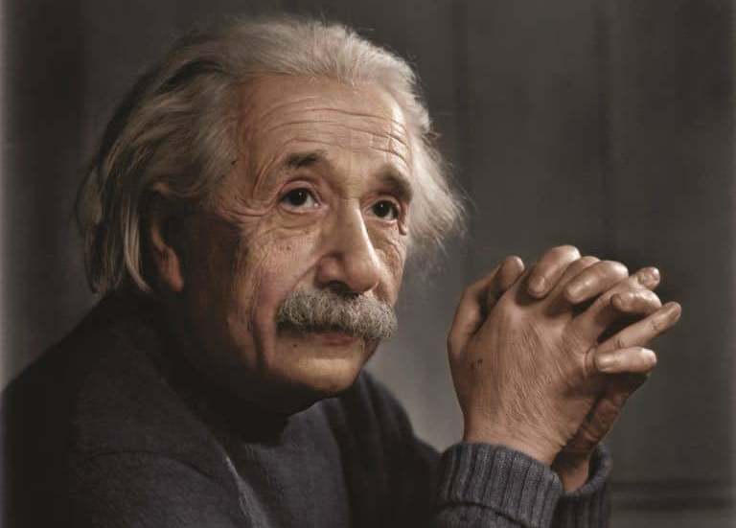
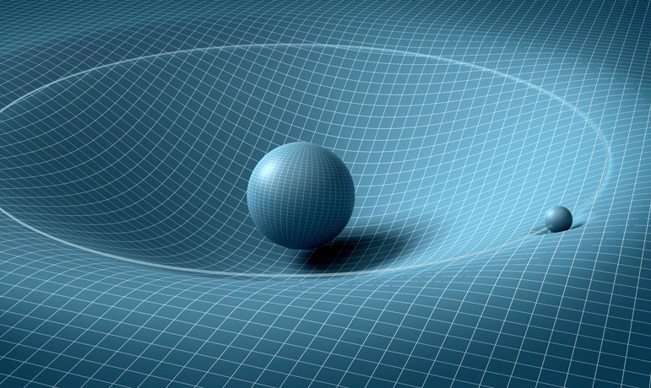
General Relativity
Used in determining properties of AGN
Predicts the paths light rays take in curved spacetime
Image Credit: https://cdn-images-1.medium.com/max/1000/1*H2TOpTVla4VCsGVuS2enAQ.jpeg
Image Credit: https://cdn.insidetheperimeter.ca/wp-content/uploads/2015/11/Albert_einstein_by_zuzahin-d5pcbug-WikiCommons-768x706.jpg

Slide 9

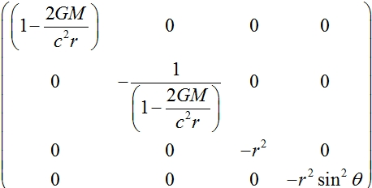
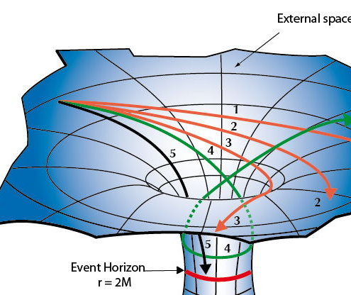
Schwarzchild Solution
Models a stationary black hole, ie not spinning
Describes a singularity with an event horizon

Slide 10
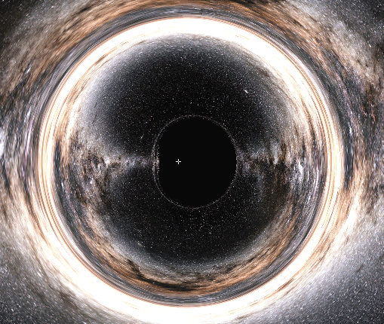
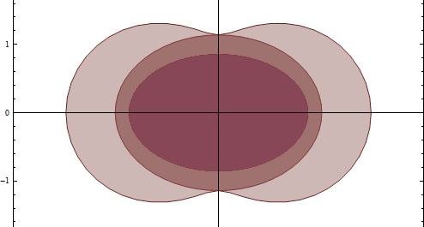
Kerr Solution
Image Credit: Yukterez (Simon Tyran, Vienna) - http://notizblock.yukterez.net/viewtopic.php?p=533
Accounts for black hole spin
Model used for ray tracing simulations
Generally accepted model
Has more than one “event horizon”
Image Credit: Yukterez (Simon Tyran, Vienna) - https://en.wikipedia.org/wiki/Ergosphere

Slide 11
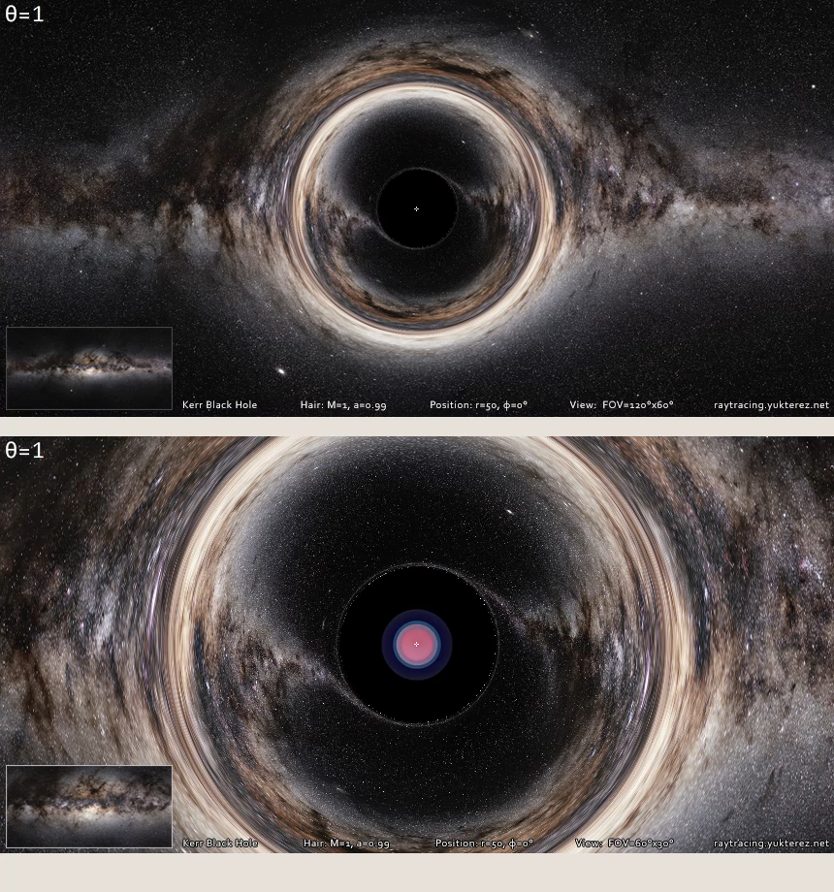
Kerr Solution
Simlulated ray tracing using Kerr-Newman solution
One of many simulations available at http://notizblock.yukterez.net/viewtopic.php?p=533
Video Credit: Yukterez (Simon Tyran, Vienna) - http://notizblock.yukterez.net/viewtopic.php?p=533

Slide 12
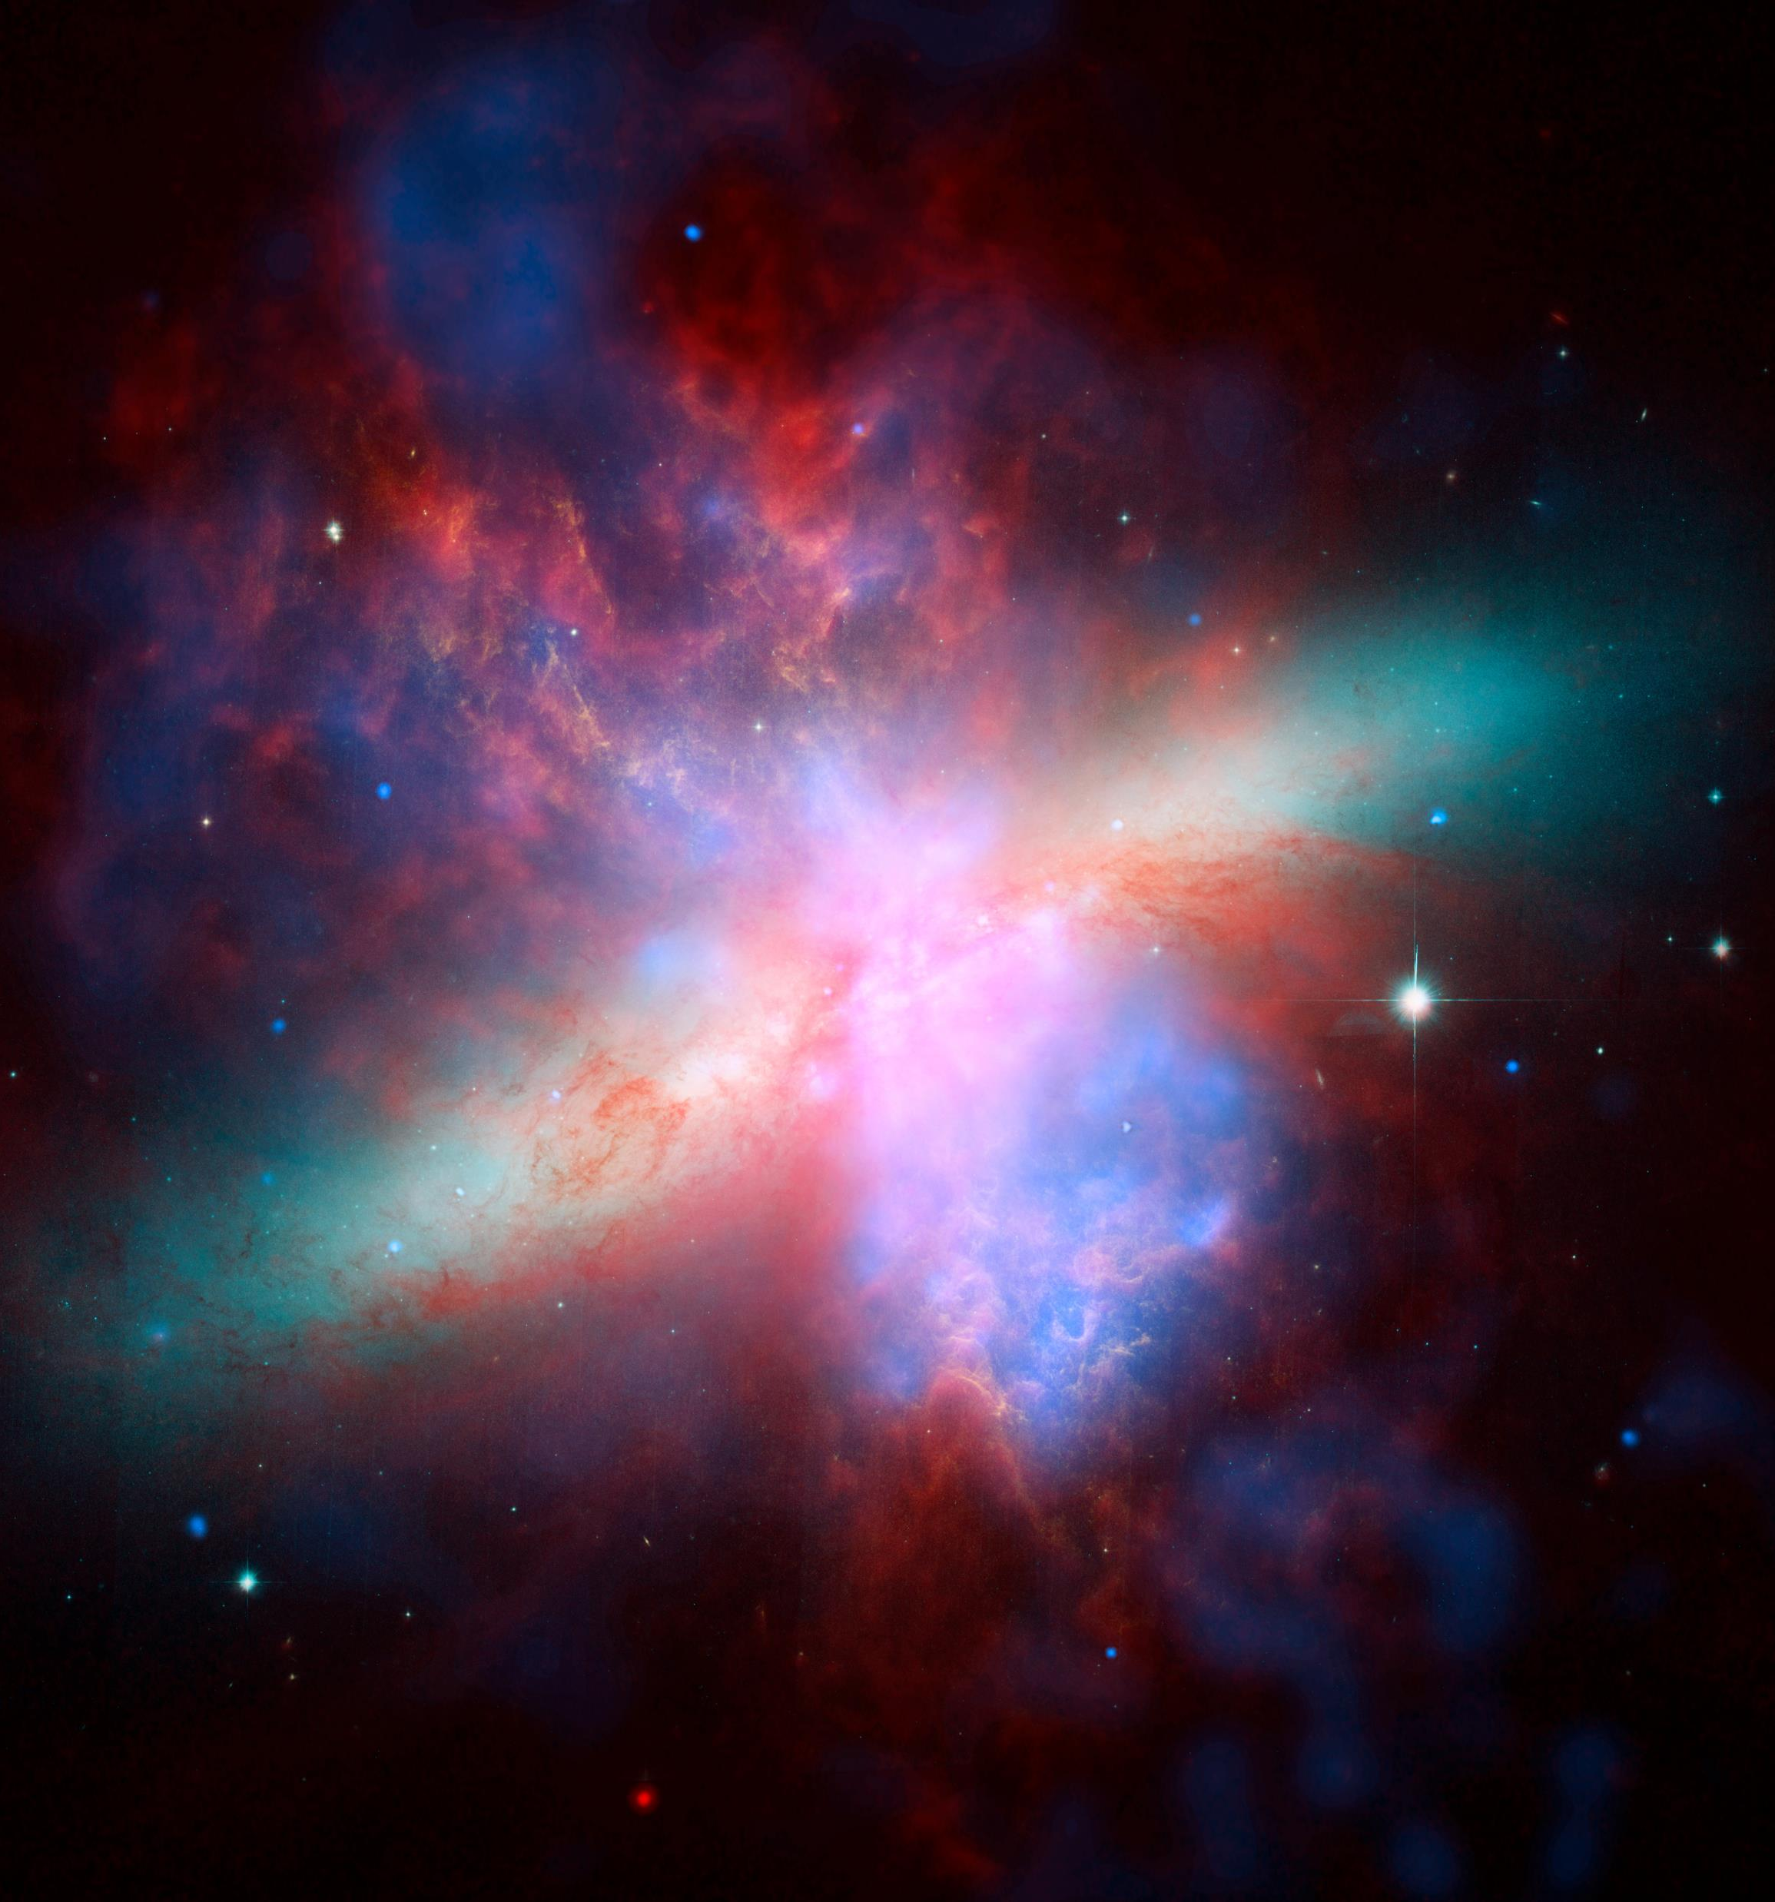
Image Credit: ESA/Hubble & NASA - https://www.spacetelescope.org/images/heic0604d/
Active Galaxies
Extremely bright centers
Hosts to supermassive black holes
Central black hole actively accreting
Highly variable spectra
Central engines called Active Galactic Nuclei (AGN)

Slide 13
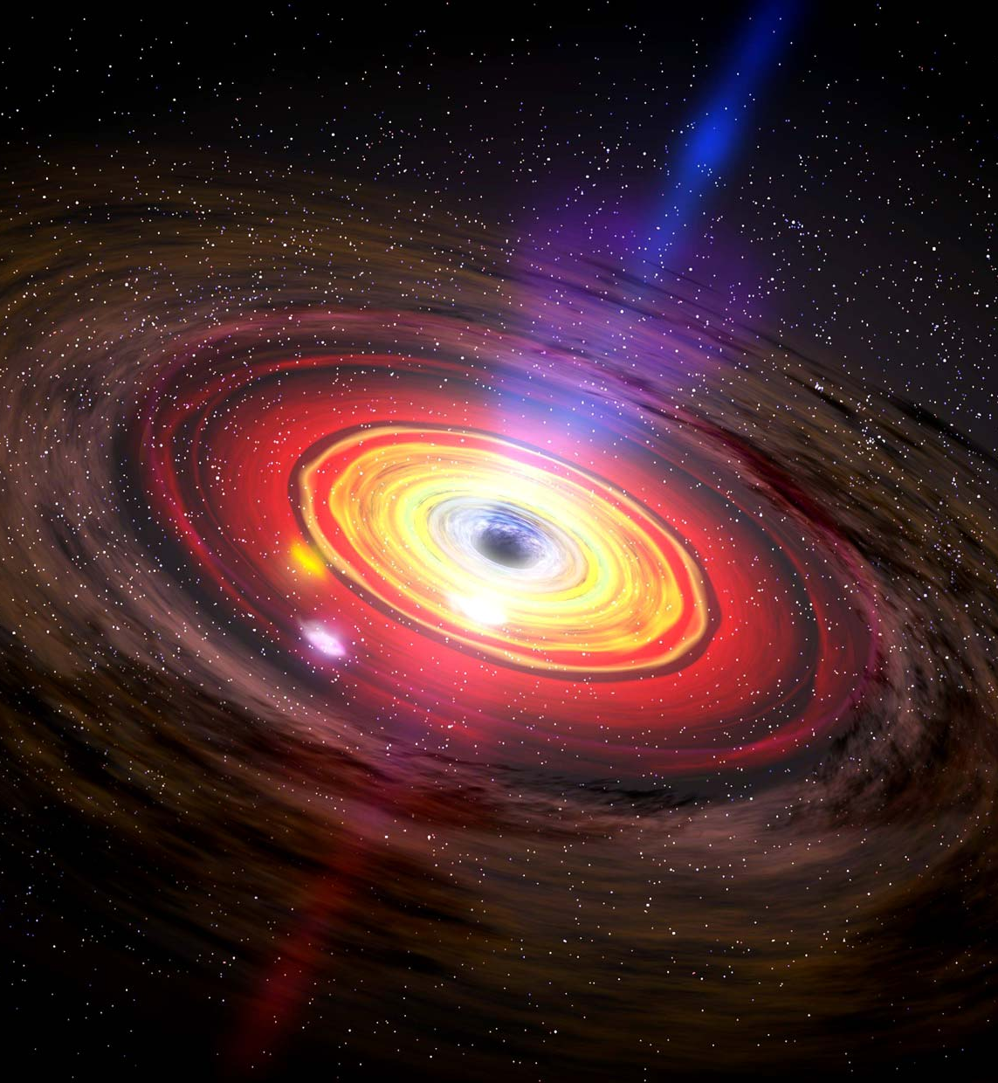
How we see AGN
Fill
Image Credit: https://www.britannica.com/science/black-hole/media/67925/196036

Slide 14
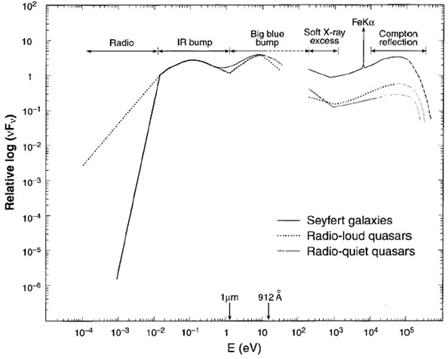
AGN Emission Spectra
Relatively flat spectra
Telescopes record individual photon energy
Photon counts sorted by energy level

Slide 15
Types of AGN

Slide 16
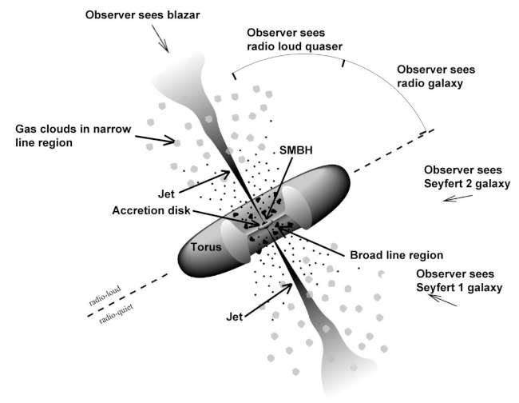
AGN brightness attributed to accretion
Viewing angle affects spectral energy distribution
Type of AGN determined by viewing angle
The Unified Model
Image Credit: https://fermi.gsfc.nasa.gov/science/eteu/agn/figure1.jpg

Slide 17
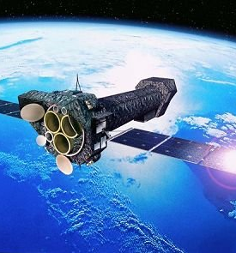
Image Credit: ESA https://www.esa.int/spaceinimages/Images/2000/11/XMM-Newton_artist_s_impression
How AGN are Observed
AGN are observed indirectly
The process of accretion causes large amounts of UV and X-ray emission
Satellite telescopes are used due to atmospheric absorption

Slide 18
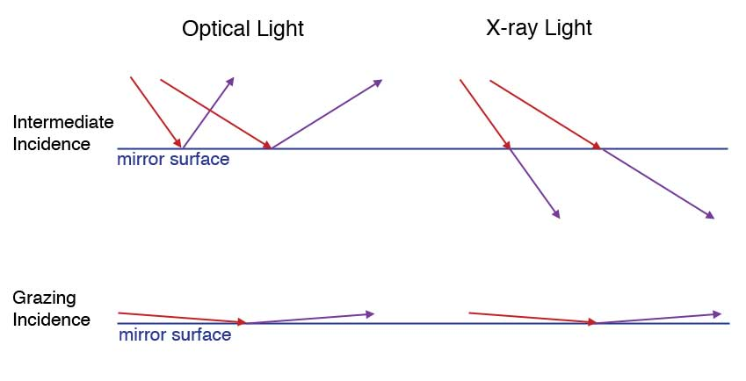
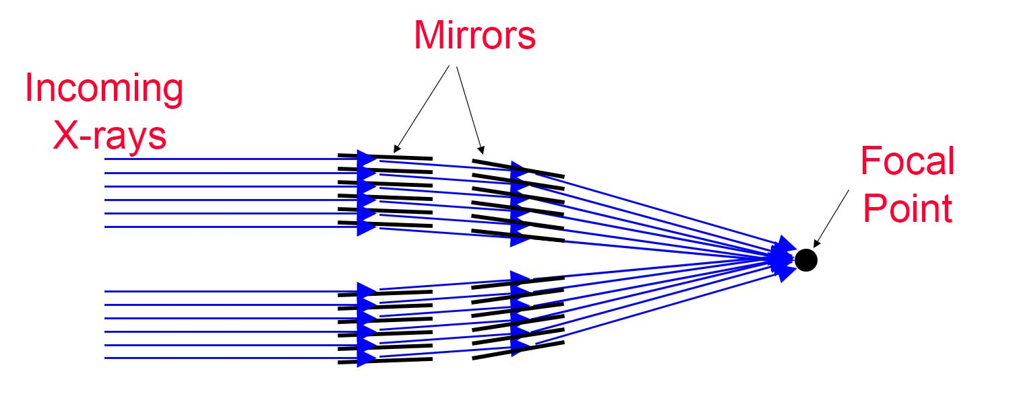
How AGN are Observed
X-rays cannot be captured like optical light
Process known as grazing incidence used
X-ray telescopes employ many mirrors

Slide 19
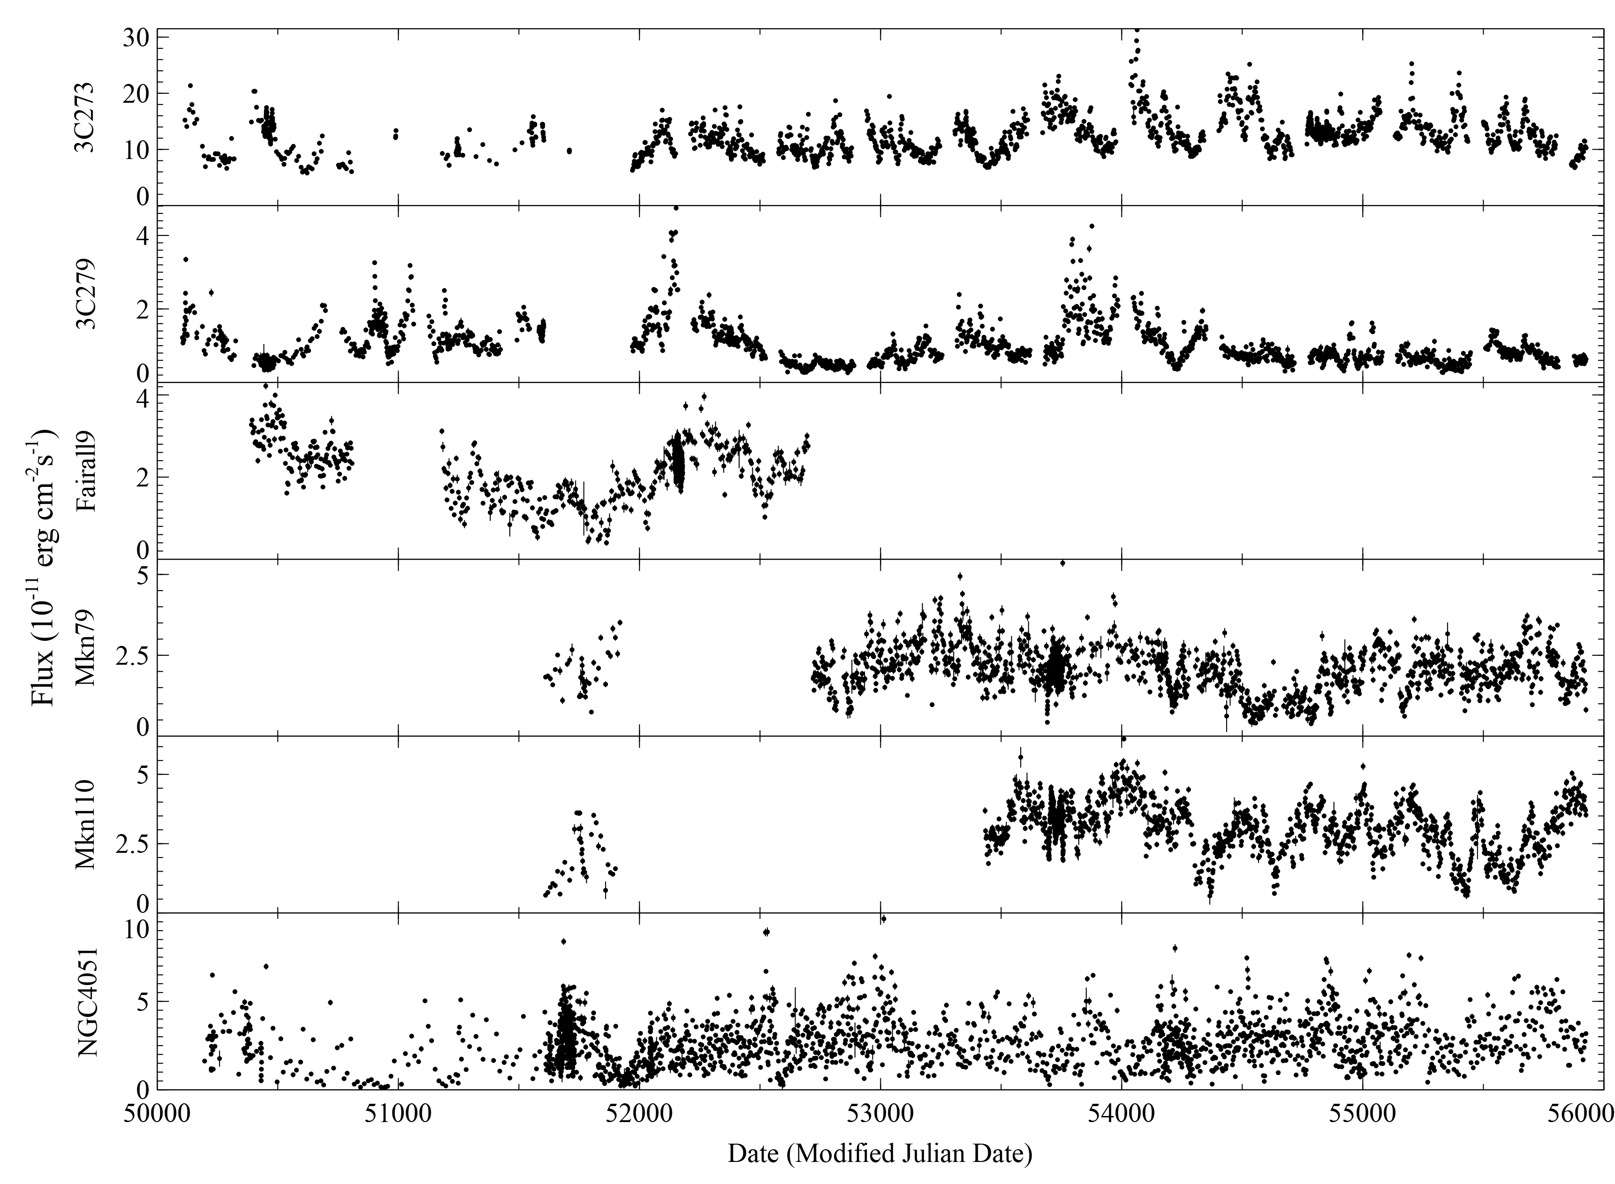
The Data
Data on 6 sources from the RXTE AGN Timing & Spectral Database used
Most very well sampled
Uneven sampling due to collection methods
Variety of object types

Slide 20

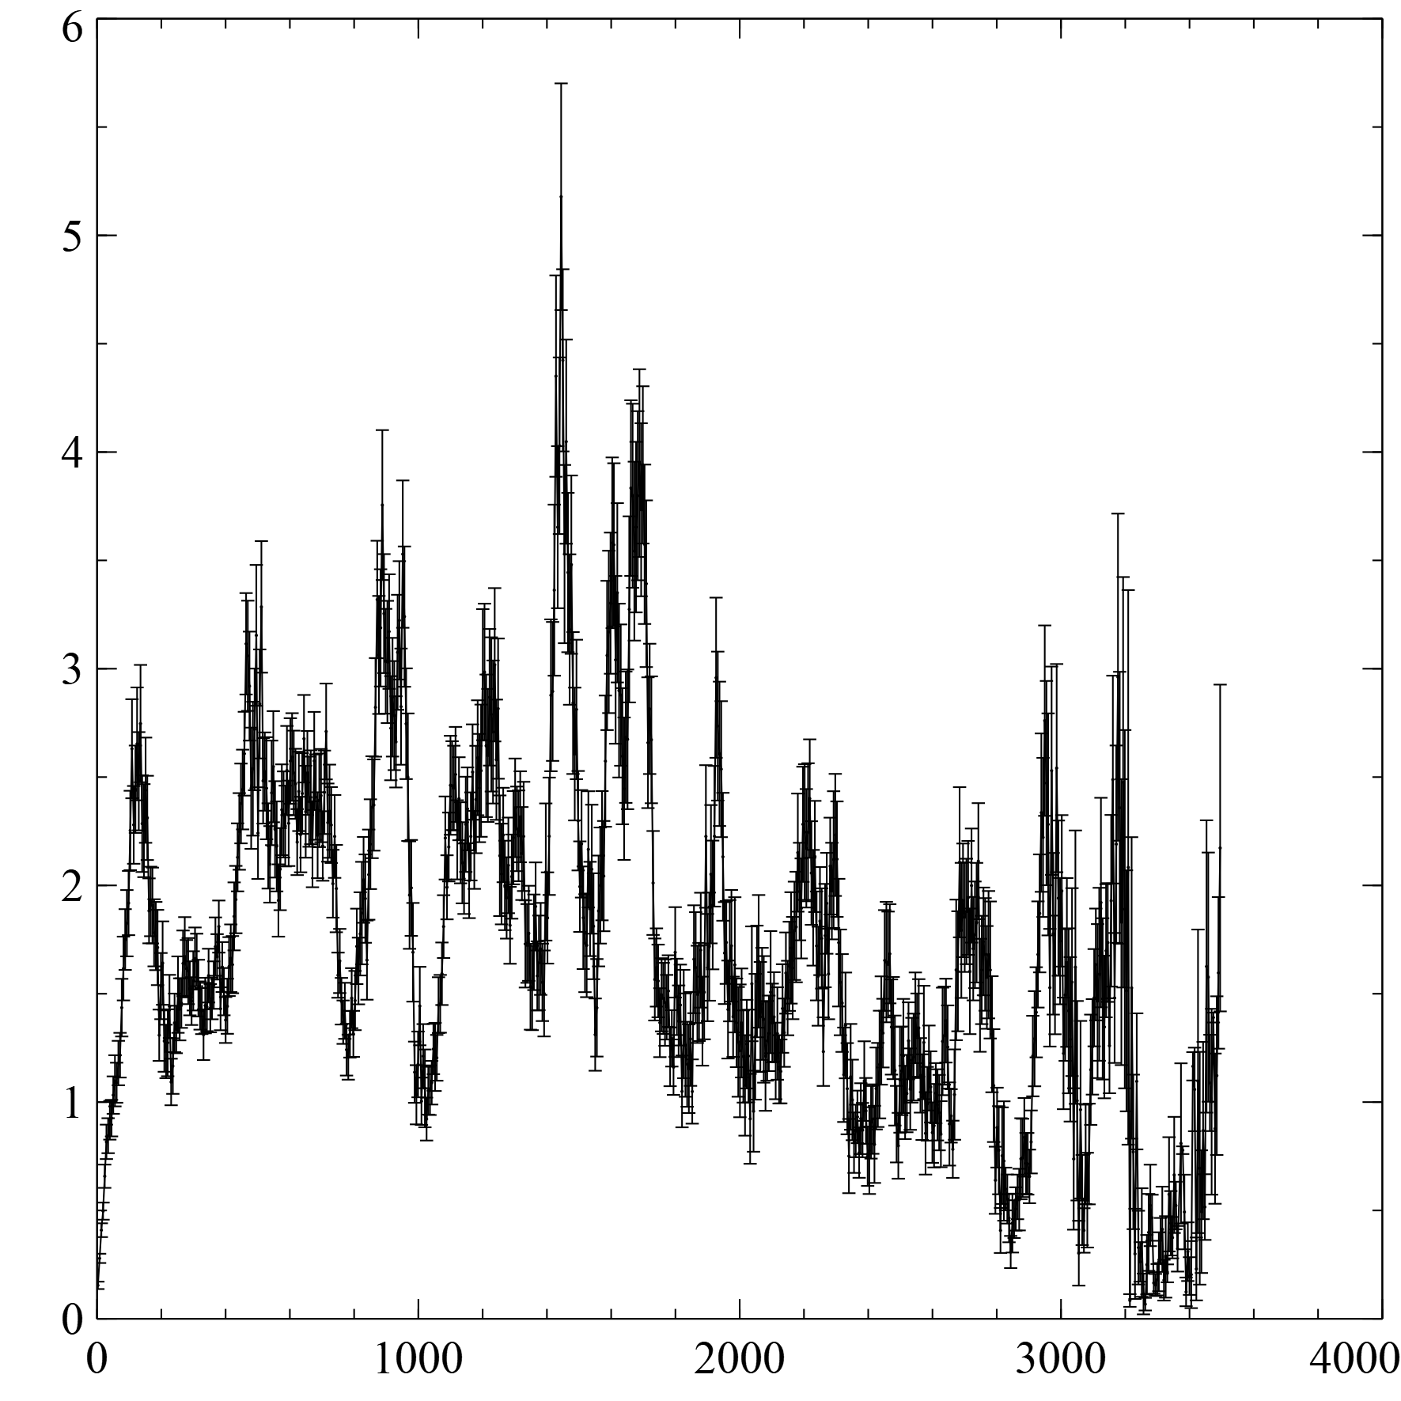
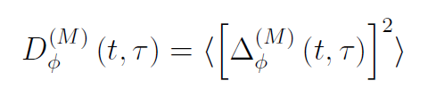
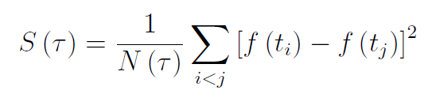
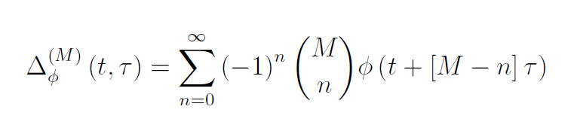
Structure Function
Mth order structure function removes (M – 1) order polynomials
Removes any non-stationary random processes
Remains in the time domain
Gallo et al 2018

Slide 21
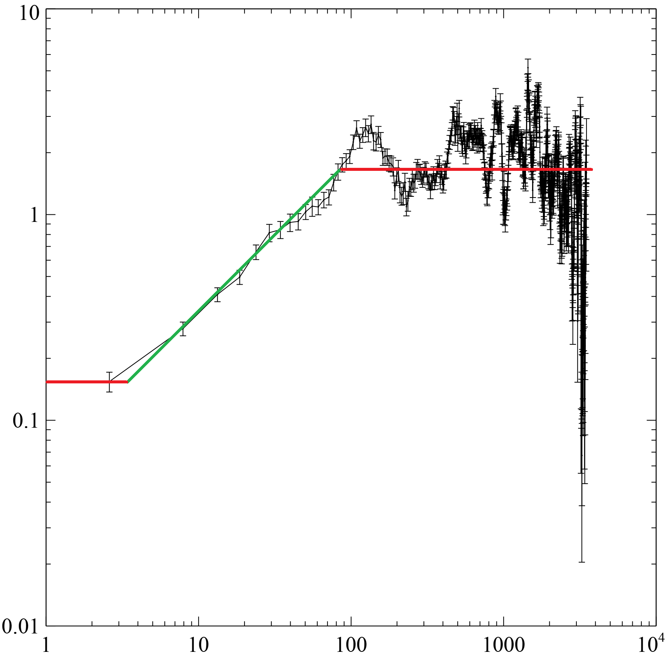
Structure Function
Linear trends artificially steepen the structure function
Takes the shape of a sigmoid
Connecting region can be fit with a power law model
Generally Visualized on log scaled axes
Gallo et al 2018

Slide 22


Writing a Structure Function Program
Written in C++
Consists of 5 classes and several hundred lines of code
Publicly available on GitHub

Slide 23
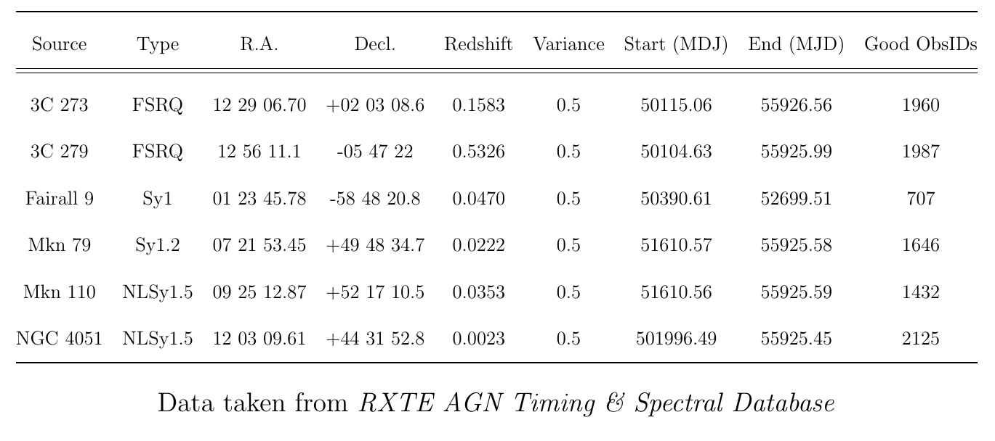
Source List

Slide 24
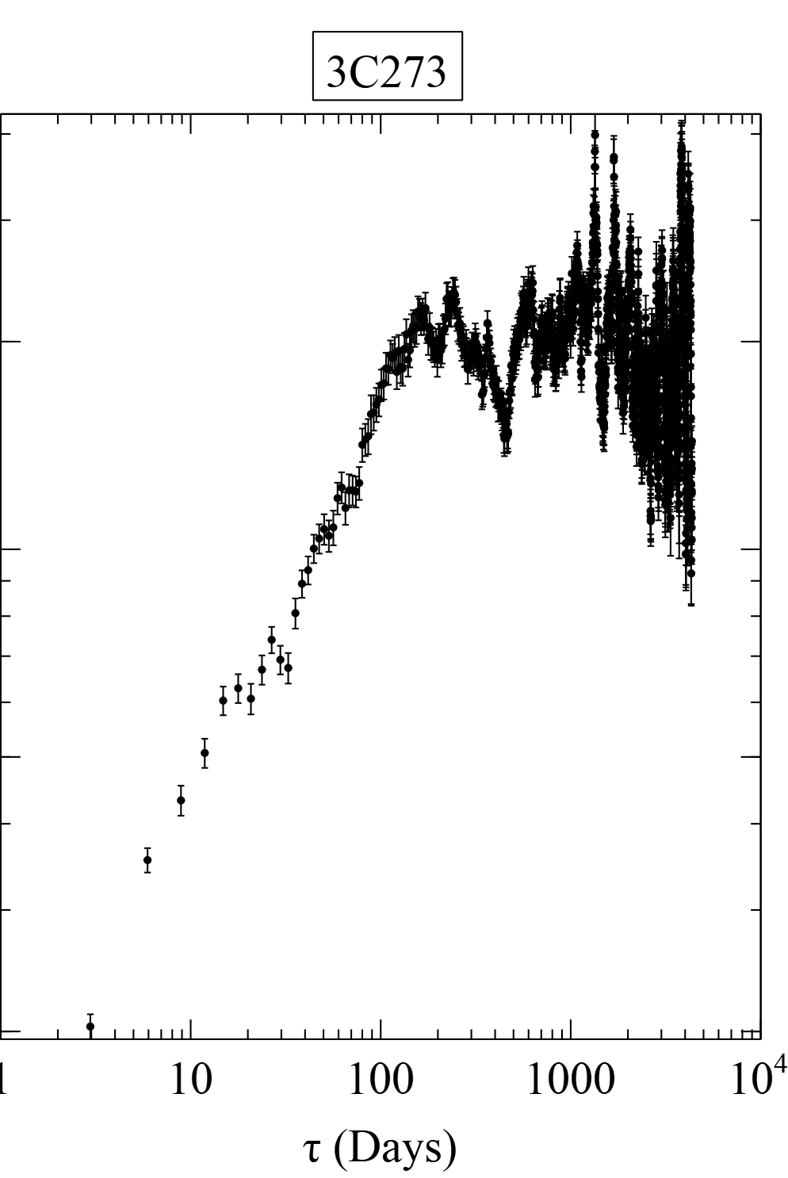
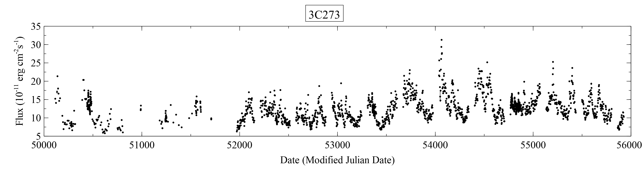
3C 273

Slide 25
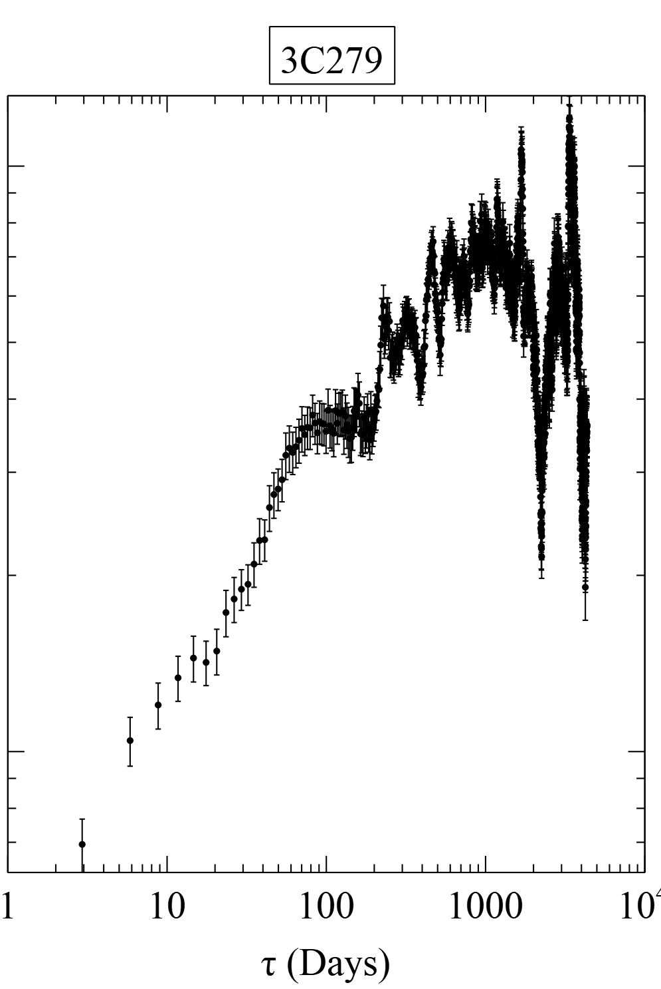
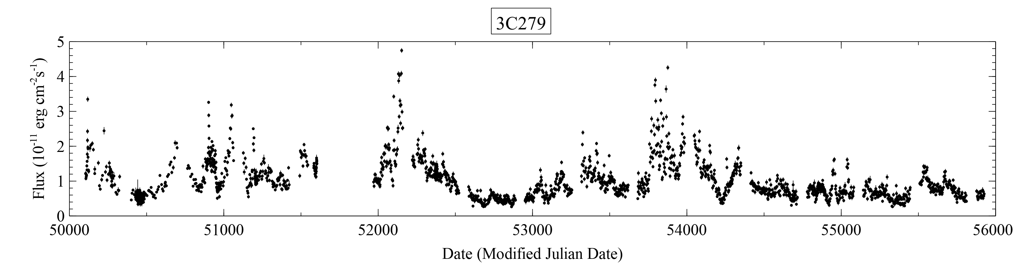
3C 279

Slide 26
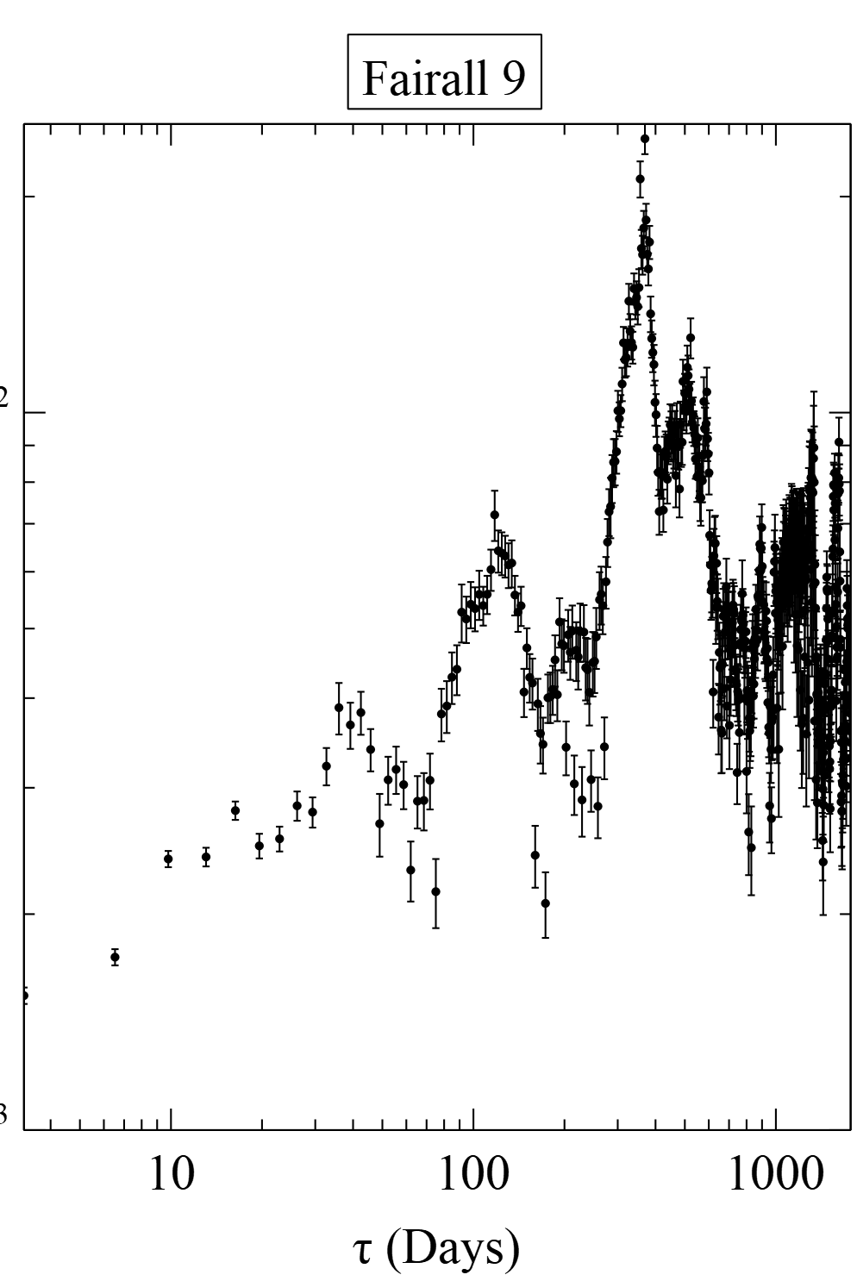
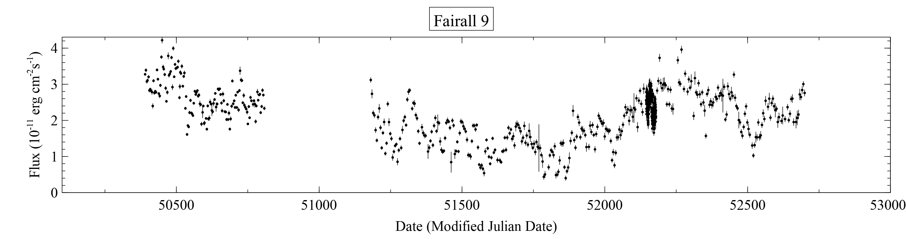
Fairall 9

Slide 27
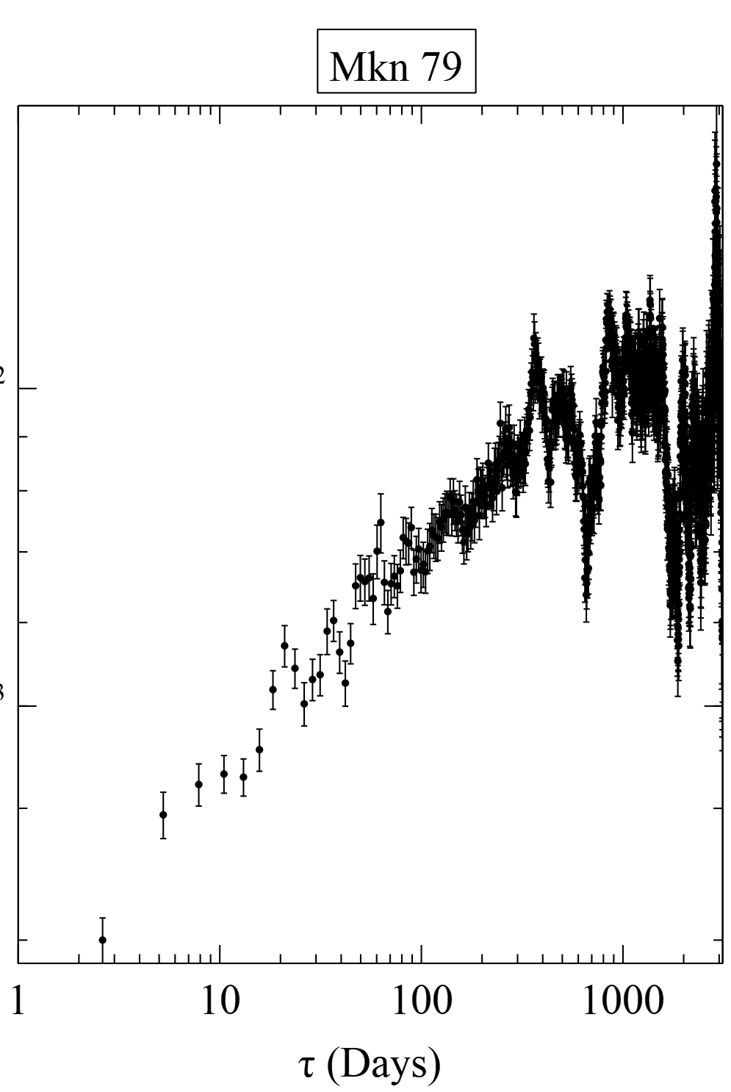
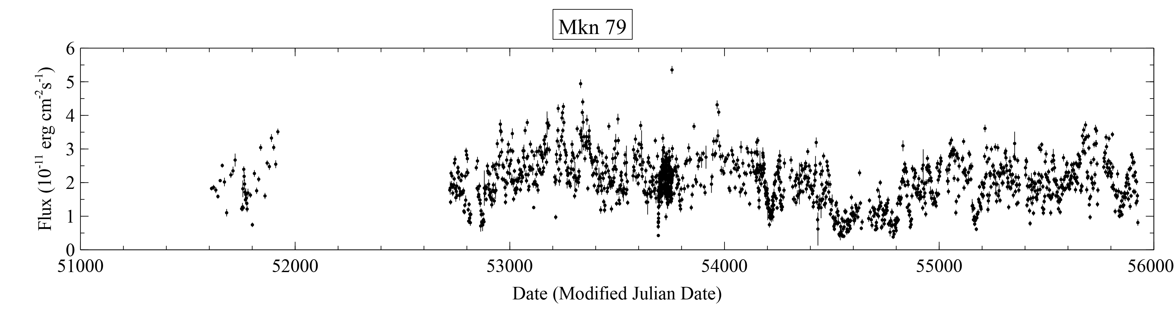
Mkn 79

Slide 28
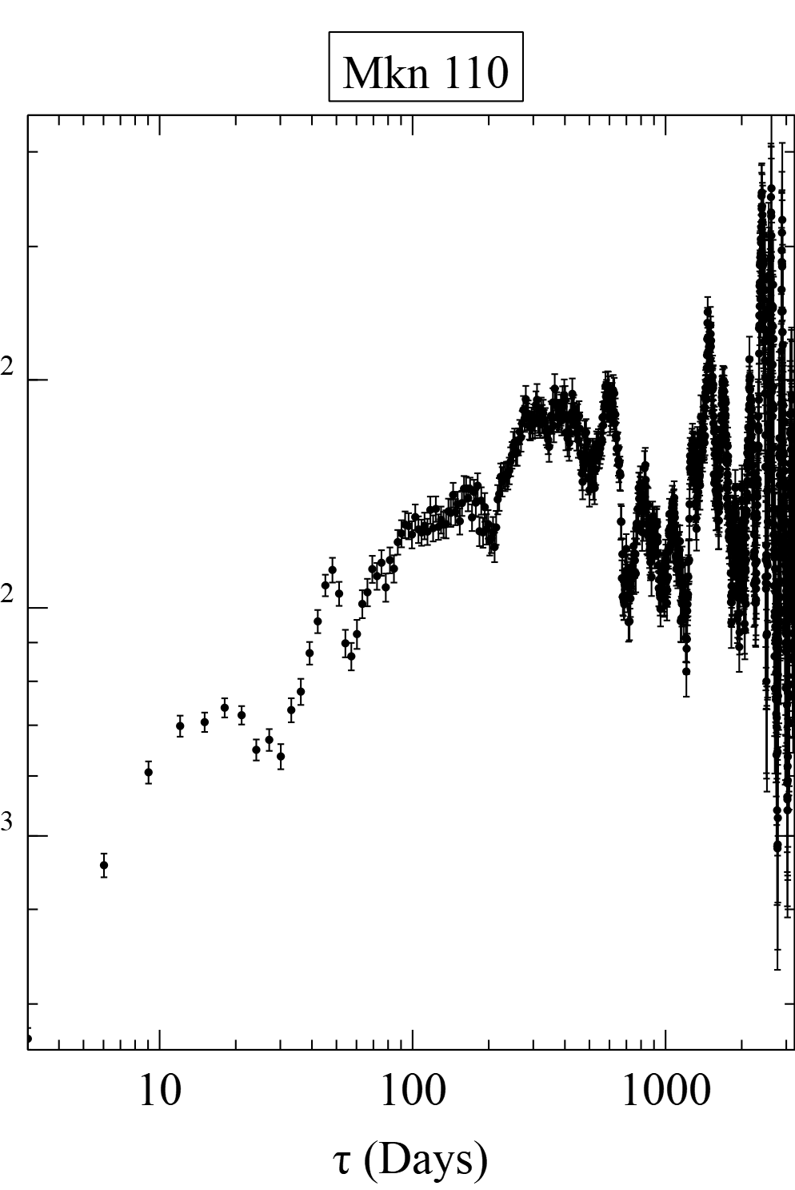
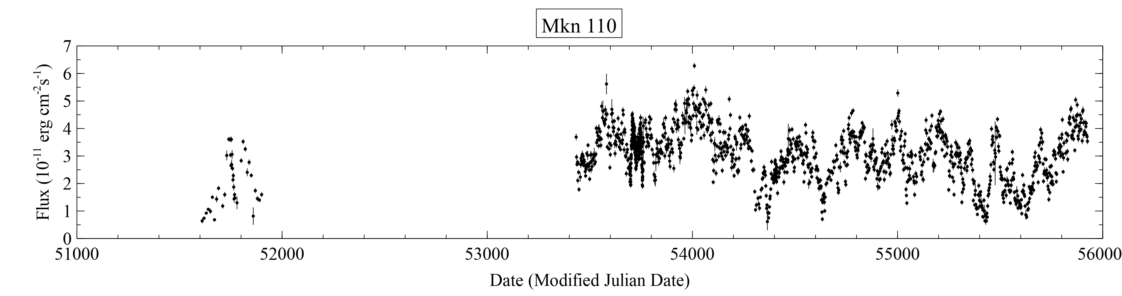
Mkn 110

Slide 29
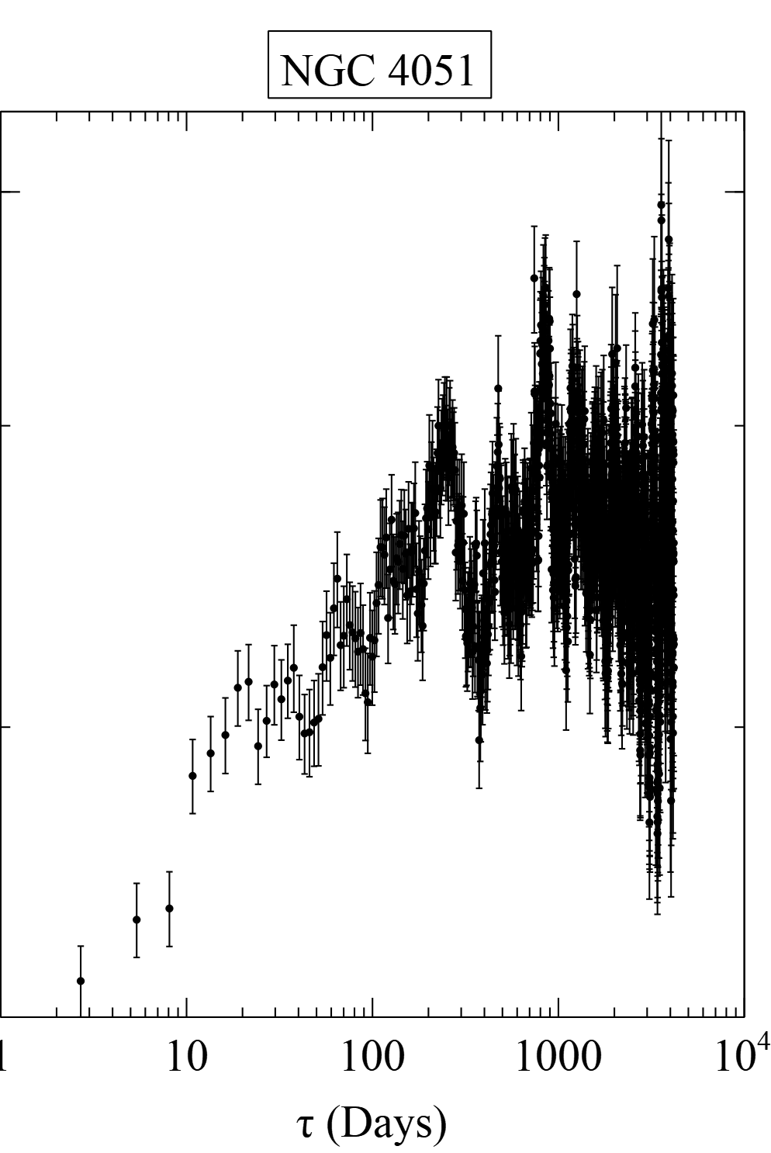
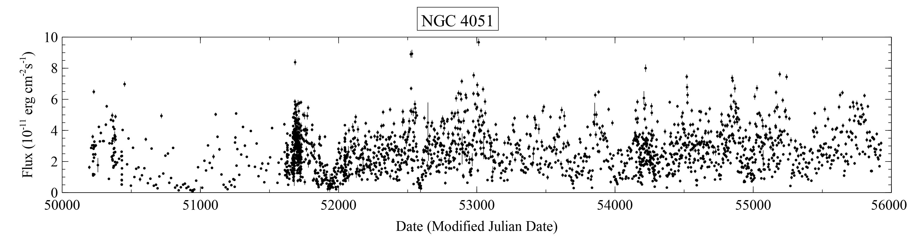
NGC 4051

Slide 30
Gallo et al 2018 results

Slide 31
Future Work

Slide 32
Thanks

